Slide 1
SQL Server
Database Development
(Based on MS SQL Server 2005 & 2008)
Md. Mahedee Hasan
Software Architect
Leadsoft Bangladesh Limited
E-mail: mahedee.hasan@gmail.com
Web: http://mahedee.net/

Slide 2
Contents
Introduction
SQL Server Objects
SQL Server Database
Table
SQL Server Data Types
Introduction to Relationships
Constraints
Identity Columns
Computed Columns
Indexes
View Basics
SQL DML and DDL
SELECT Statement
DISTINCT Statement

Slide 3
Contents…
WHERE Clause
AND, OR operations
ORDER BY Keyword
INSERT INTO Statement
UPDATE Statement
DELETE Statement
TOP Clause
SQL LIKE Operator
SQL Wildcards
The IN Operator
SQL BETWEEN Operator
Joins and Set Operations
INNER JOIN
OUTER JOIN
CROSS JOIN

Slide 4
Contents…
LEFT OUTER JOIN WHERE NULL
RIGHT OUTER JOIN WHERE NULL
OUTER JOIN WHERE NULL
UNION
UNION ALL
Subquery
Aggregate functions
Stored Procedure
Anatomy of Stored Procedure
Stored Procedure with output parameter
User defined function
Scalar Function
Table valued function
Trigger
DML Triggers
ACID

Slide 5
Introduction
SQL - Structured Query Language
  The standard for relational database management systems (RDBMS)
Microsoft SQL Server is a relational database management system.
It is a software product whose primary function is to store and retrieve data

Slide 6
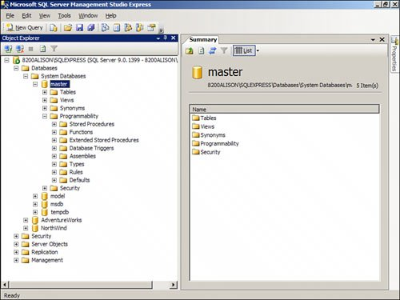
SQL Server Objects
System Objects
  System databases include Master, Model, MSDB, Resource, TempDB, and Distribution
  SQL Server creates these databases during the installation process
  There are also system tables, stored procedures, functions, and other system objects

Slide 7
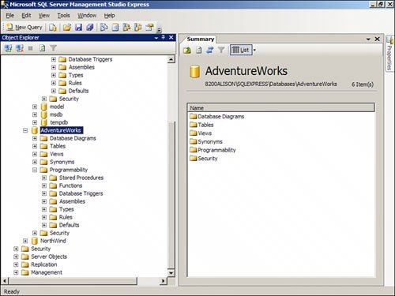
SQL Server Objects…
User Objects
  User objects include the databases, stored procedures, functions, and other database objects
  You can add and drop user objects as necessary

Slide 8
SQL Server Database
Database is a container for objects
  Store data
  Enable data storage and retrieval in a secure and safe manner
A SQL Server 2008 database can hold the following
  Table definitions
  Columns within those tables, which make up rows of data
  Programs (either stored procedures written using T-SQL or assemblies) used to access or manipulate the data
  Indexes, which are used to speed up the retrieval of data
  Views, which are specialized ways of looking at the actual data
  Functions, which are repetitive tasks that can be applied to rows of data

Slide 9
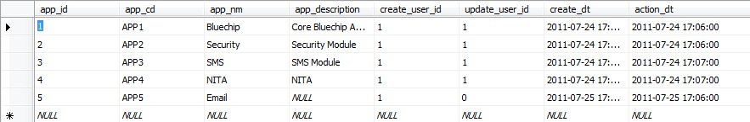
Table
Is a repository for data
Items of data grouped in one or more columns
Tables contain zero or more rows of information

Slide 10
Table…
Create Table
  Syntax/Example:
    CREATE TABLE [dbo].[hrm_grade](
    [grade_cd] [tinyint] NOT NULL,
    [grade_nm] [varchar](50) NOT NULL,
    [usr_id] [smallint] NOT NULL,
    [action_tp] [bit] NOT NULL,
    [action_dt] [smalldatetime] NOT NULL,
    [rowguid] [uniqueidentifier] ROWGUIDCOL NOT NULL,
    CONSTRAINT [PK_hrm_grade] PRIMARY KEY CLUSTERED
    (
    [grade_cd] ASC
    )
    )
Notes:
Cluster index sorts the data with respect to the column on which it is applied, where as non-clustered index do not, it is just a logical sorting. Thus we can have only single clustered index and multiple non-clustered index on a table

Slide 11
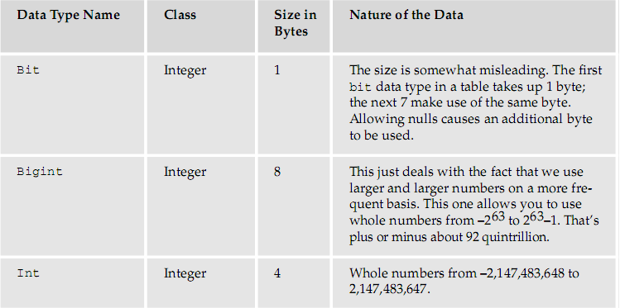
SQL Server Data Types

Slide 12
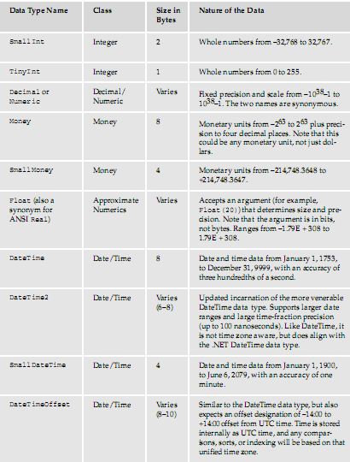
SQL Server Data Types…

Slide 13
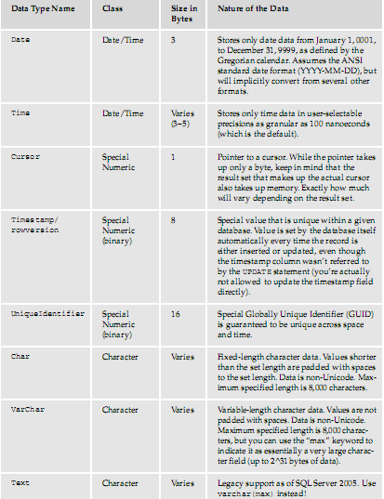
SQL Server Data Types…

Slide 14
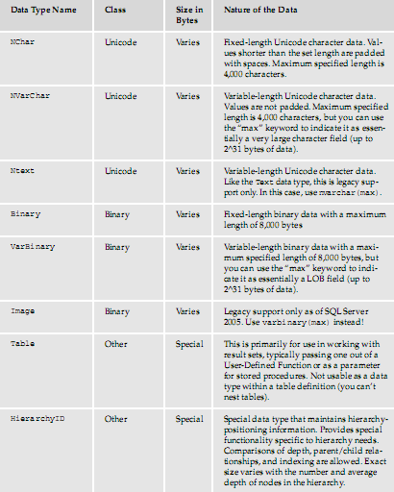
SQL Server Data Types…

Slide 15
Introduction to Relationships
Three types of relationships can exist between tables in a database
  One-to-many
  One-to-one
  Many-to-many
The right type of relationship between two tables ensures
  Data integrity
  Optimal performance
  Ease of use in designing system objects
Notes:
In computing, data integrity refers to maintaining and assuring the accuracy and consistency of data over its entire life-cycle

Slide 16
Introduction to Relationships…
One to Many
  A record in one table can have many related records in another table
One to One
  Each record in the table on the one side of the relationship can have only one matching record in the table on the other side of the relationship
Many to Many
  Each record in the table on the one side of the relationship can have only one or many matching record in the table on the other side of the relationship or vice versa.
Notes:
In computing, data integrity refers to maintaining and assuring the accuracy and consistency of data over its entire life-cycle

Slide 17
Constraints
Constraints limit or control the types of data that the user can enter into tables
There are seven main categories of constraints.
  Primary key constraints
  Foreign key constraints
  Default constraints
  Not null constraints
  Check constraints
  Rules
  Unique constraints.

Slide 18
Constraints…
Primary Key Constraints
  Primary key constraint is a column or a set of columns that uniquely identify a row in the table
  Can be more than one field as the primary key
  Syntax/Example:
    ALTER TABLE Authors
    ADD CONSTRAINT pk_authors PRIMARY KEY (AuthorID)

Slide 19
Constraints…
Foreign Key Constraints
  Foreign key constraint consists of a column or of a set of columns that participates in a relationship with a primary key table.
  Primary key is on the one side of the relationship, whereas the foreign key is on the many side of the relationship.
  Syntax/Example:
    ALTER TABLE Orders
    ADD FOREIGN KEY (P_Id)
    REFERENCES Persons(P_Id)

Slide 20
Constraints…
Default Constraints
  Default constraint is a value that SQL Server automatically places in a particular field in a table.
  Default value can be a constant, Null, or a function
  Syntax/Example:
    ALTER TABLE Persons
    ALTER City SET DEFAULT 'SANDNES'

Slide 21
Constraints…
Not null Constraints
  Require the user to enter data into a field
  Syntax/Example:
    ALTER TABLE ConstraintTable
    ALTER COLUMN ID INT NOT NULL
Check Constraints
  Check constraints limit the range of values that a user can enter into a column.
  Can enter as many check constraints as you want for a particular column.
  Syntax/Example:
    ALTER TABLE Person.Address
    ADD CONSTRAINT CK_Address_PostalCode
    CHECK (LEN(PostalCode) < 11)

Slide 22
Constraints…
Unique Constraints
  Unique constraint requires that each entry in a particular column be unique
  Syntax/Example:
    ALTER TABLE Authors ADD CONSTRAINT IX_Authors_Name UNIQUE(Name)

Slide 23
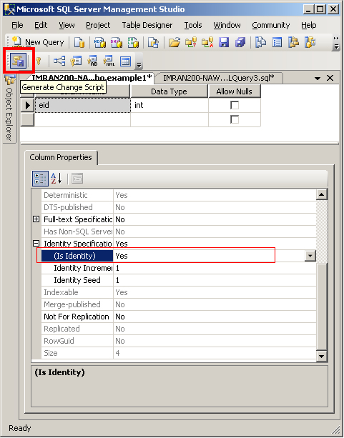
Identity Columns
Provides an auto incrementing value for a table
Should use an identity column as the primary key field for any table that has no natural primary key that is short, stable, and simple
Identity columns are often of the int data type

Slide 24
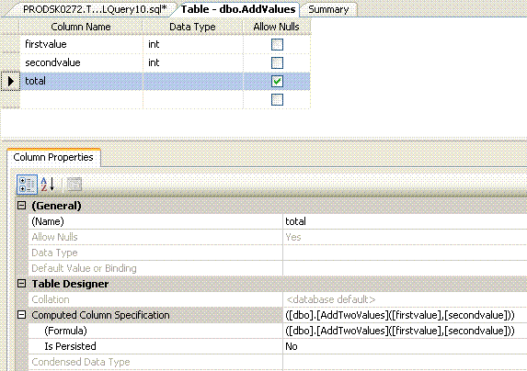
Computed Columns
With computed columns, you can create a column that is based on data in other columns.
SQL Server automatically updates the computed column when the columns on which it depends are updated.

Slide 25
Indexes
Indexes to improve performance when the user searches a field
It's generally best to include too many indexes rather than too few
Indexes speed up searching, sorting, and grouping data
The downside is that they take up hard disk space and slow the process of editing, adding, and deleting data

Slide 26
Indexes…
Syntax/Example:
  Single non clustered index
    CREATE UNIQUE NONCLUSTERED INDEX IX_NC_PresidentNumber
    ON dbo.Presidents (PresidentNumber)
  Multi-column (composite) clustered index
    CREATE UNIQUE CLUSTERED INDEX IX_C_PresidentNumber
    ON dbo.Presidents (PresidentNumber,PresidentName)

Slide 27
View Basics
A view is a virtual Table
Its contents are based on query
Like a table, a view is composed of rows and columns
Data in a view comes from one or more tables or views in the database
    Syntax: {CREATE} {ALTER} VIEW view_name [( column [ ,... n ] } ] [ WITH < view_option > [ ,... n ] ] AS select_statement [ WITH CHECK OPTION ]
    Example:
    Create View dbo.vInventoryCost WITH SCHEMABINDING
    as select ET.EqType, e.Make, e.Model, Sum(Cost) TotalCost, Count)*) [Count] from dbo.Inventory I inner join dbo.Equipment e on i.EqId = e.EqId
    inner join dbo.EqType ET on e.EqTypeId = ET.EqTypeId
    where Cost is not null group by ET.EqType, e.Make, e.Model

Slide 28
SQL DML and DDL
Data Manipulation Language (DML)
  SELECT - extracts data from a database
  UPDATE - updates data in a database
  DELETE - deletes data from a database
  INSERT INTO - inserts new data into a database
Data Definition Language (DDL)
  CREATE DATABASE - creates a new database
  ALTER DATABASE - modifies a database
  CREATE TABLE - creates a new table
  ALTER TABLE - modifies a table
  DROP TABLE - deletes a table
  CREATE INDEX - creates an index (search key)
  DROP INDEX - deletes an index

Slide 29
SELECT Statement
The most basic select statement retrieve all rows and all columns from a table.
  SELECT * FROM Persons
  or
  SELECT LastName, FirstName FROM Persons
Best Practices
  Breaking line for readability
  It is good idea to place comma at the beginning of the next line.

Slide 30
DISTINCT Statement
The DISTINCT keyword can be used to return only distinct (different) values
  SELECT DISTINCT column_name(s)
  FROM table_name
  SELECT DISTINCT City FROM Persons

Slide 31
WHERE Clause
The WHERE clause is used to extract only those records that fulfill a specified criterion
  SELECT * FROM dbo.hrm_employee
  WHERE marital_stat = 'U'

Slide 32
AND & OR Operators
The AND operator displays a record if both the first condition and the second condition are true.
  SELECT * FROM dbo.hrm_employee
  WHERE marital_stat = 'U' AND unit_cd = 100
The OR operator displays a record if either the first condition or the second condition is true.
  SELECT * FROM dbo.hrm_employee
  WHERE marital_stat = 'U' OR unit_cd = 100

Slide 33
ORDER BY Keyword
The ORDER BY keyword is used to sort the result-set by a specified column.
The ORDER BY keyword sorts the records in ascending order by default.
If you want to sort the records in a descending order, you can use the DESC keyword.
  SELECT column_name(s)
  FROM table_name
  ORDER BY column_name(s) ASC|DESC

Slide 34
INSERT INTO Statement
The INSERT INTO statement is used to insert a new row in a table.
It is possible to write the INSERT INTO statement in two forms.
  INSERT INTO table_name
  VALUES (value1, value2, value3,...)
  INSERT INTO table_name (column1, column2, column3,...) VALUES (value1, value2, value3,...)

Slide 35
UPDATE Statement
The UPDATE statement is used to update existing records in a table.
  UPDATE table_name
  SET column1=value, column2=value2,...
  WHERE some_column=some_value
  UPDATE Persons
  SET Address='Nissestien 67', City='Sandnes'
  WHERE LastName='Tjessem' AND FirstName='Jakob'

Slide 36
DELETE Statement
The DELETE statement is used to delete rows in a table
  DELETE FROM table_name
  WHERE some_column=some_value
  DELETE FROM Persons
  WHERE LastName='Tjessem' AND FirstName='Jakob‘
  DELETE FROM table_name
  or
  DELETE * FROM table_name

Slide 37
TOP Clause
The TOP clause is used to specify the number of records to return
  SELECT TOP 1 * FROM employee_info

Slide 38
SQL LIKE Operator
LIKE operator is used to search for a specified pattern in a column.
  SELECT * FROM Persons
  WHERE City LIKE 's%‘
The "%" sign can be used to define wildcards (missing letters in the pattern) both before and after the pattern.

Slide 39
SQL Wildcards
SQL wildcards can substitute for one or more characters when searching for data in a database
Wildcard | Description
% | A substitute for zero or more characters
_ | A substitute for exactly one character
[charlist] | Any single character in charlist
[^charlist]or [!charlist] | Any single character not in charlist

Slide 40
SQL Wildcards…
SELECT * FROM Persons
WHERE FirstName LIKE '_la‘
SELECT * FROM Persons
WHERE LastName LIKE 'S_end_on‘
SELECT * FROM Persons
WHERE LastName LIKE '[bsp]%‘
SELECT * FROM Persons
WHERE LastName LIKE '[!bsp]%'

Slide 41
The IN Operator
The IN operator allows you to specify multiple values in a WHERE clause.
SELECT column_name(s)
FROM table_name
WHERE column_name IN (value1,value2,...)
SELECT * FROM Persons
WHERE LastName IN ('Hansen','Pettersen')

Slide 42
SQL BETWEEN Operator
The BETWEEN operator selects a range of data between two values. The values can be numbers, text, or dates.
  SELECT column_name(s)
  FROM table_name
  WHERE column_name
  BETWEEN value1 AND value2
  SELECT * FROM Persons
  WHERE LastName
  BETWEEN 'Hansen' AND 'Pettersen'

Slide 43
SQL Alias
With SQL, an alias name can be given to a table or to a column.
  SELECT column_name(s)
  FROM table_name
  AS alias_name
  SELECT column_name AS alias_name
  FROM table_name

Slide 44
Joins and Set Operations
Joins
  Joins are operations that allow you to match rows between tables.
  Different types of Joins are
    Inner Join
    Outer Join
    Right Outer Join
    Full Outer Join
    Cross Join

Slide 45
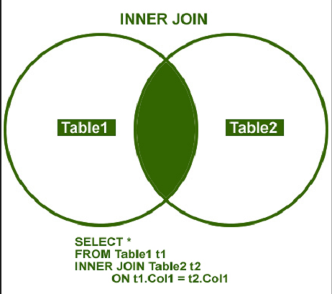
INNER JOIN
INNER JOIN returns rows when there is at least one match in both the tables
Returns matches data between table

Slide 46
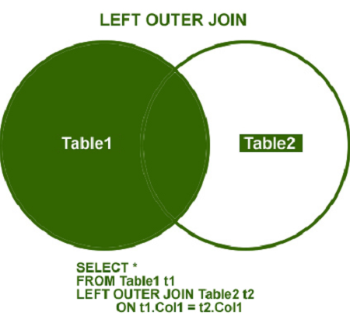
OUTER JOIN
LEFT OUTER JOIN
  Returns all the rows from the left table in conjunction with the matching rows from the right table.
  If there are no columns matching in the right table, it returns NULL values.

Slide 47
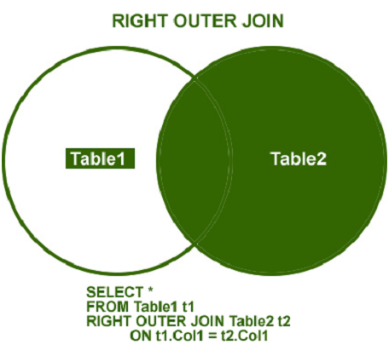
OUTER JOIN…
RIGHT OUTER JOIN
  Returns all the rows from the right table in conjunction with the matching rows from the left table.
  If there are no columns matching in the left table, it returns NULL values.

Slide 48
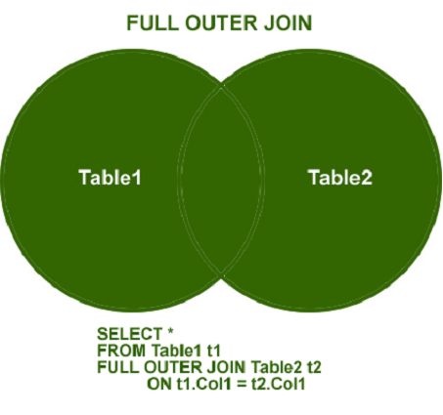
OUTER JOIN…
FULL OUTER JOIN
  Combines left outer join and right outer join.
  It returns row from either table when the conditions are met and returns null value when there is no match

Slide 49
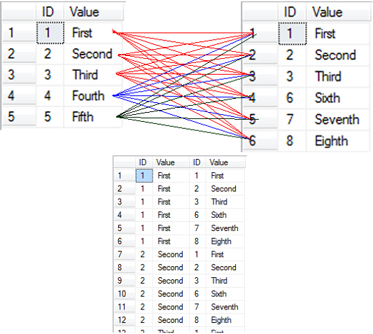
CROSS JOIN
This join is a Cartesian join that does not necessitate any condition to join.
The result set contains records that are multiplication of record number from both the tables.

Slide 50
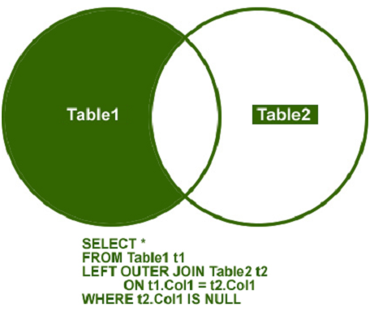
LEFT OUTER JOIN WHERE NULL

Slide 51
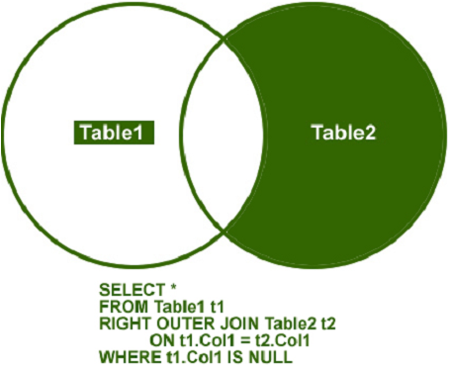
RIGHT OUTER JOIN WHERE NULL

Slide 52
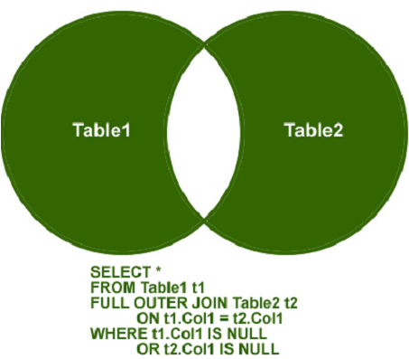
OUTER JOIN WHERE NULL

Slide 53
UNION
Used to select related information from two tables
When using the UNION command all selected columns need to be of the same data type
With UNION, only distinct values are selected.
Example:
  SELECT firstName, lastName, company FROM businessContacts
  UNION ALL
  SELECT firstName, lastName, NULL FROM nonBusinessContacts

Slide 54
UNION ALL
Allows to join multiple datasets into one dataset When using the UNION command all selected columns need to be of the same data type
Does not remove any duplicate rows
Example:
  SELECT firstName, lastName, company FROM businessContacts
  UNION ALL
  SELECT firstName, lastName, NULL FROM nonBusinessContacts

Slide 55
Subquery
Subquery is a SELECT statement within another SQL statement
Subqueries structure a complex query into isolated parts
Subqueries allow you to use the results of another query in the outer query
Example:
  SELECT *
  FROM HumanResources.Employee E
  WHERE E.EmployeeID IN ( SELECT EA.EmployeeID
  FROM HumanResources.EmployeeAddress EA
  WHERE EA.EmployeeID = E.EmployeeID)

Slide 56
Aggregate Functions
Aggregate functions that take a collection of values as input and returns a single value.
Aggregate functions ignores NULL values except COUNT function
HAVING clause is used, along with GROUP BY, for filtering query using aggregate values
Some T-SQL Aggregate functions are: AVG, COUNT, MAX, MIN, SUM

Slide 57
Aggregate Functions…
AVG – To calculate average
    Select branch_name, avg(balance) from account
    Group by branch_name having avg(balance) > 1200
COUNT - Returns the number of items in a group
    SELECT COUNT(*) FROM HumanResources.Employee;
    SELECT COUNT(DISTINCT Title) FROM HumanResources.Employee;

Slide 58
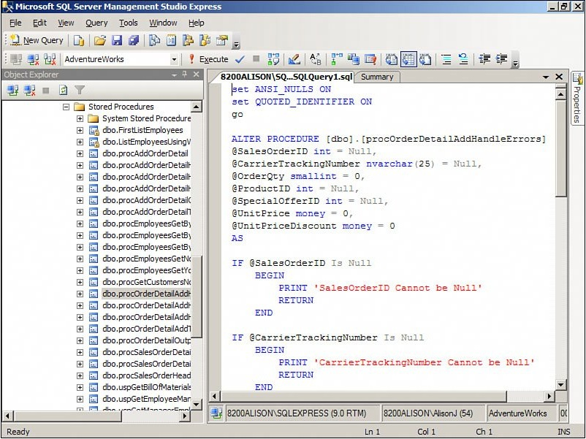
Stored Procedure
Stored procedure is a piece of programming code
Can accept input parameters and can return one or more output parameters
Stored procedures generally perform operations on the database, including the process of calling other stored procedures

Slide 59
Anatomy of Stored Procedure
A Stored procedure consists of
  A header that defines the name of the stored procedure
  Input and output parameters, and some miscellaneous processing options.
  A body that contains one or more Transact-SQL statements to be executed at runtime.
  Syntax:
    CREATE PROC[EDURE] procedure_name [ {@parameter data_type} [= default] [OUTPUT] ] [,...n]
    AS sql_statement [...n]

Slide 60
Anatomy of Stored Procedure…
A sample stored procedure
  ALTER PROCEDURE [dbo].[rsp_hrm_emp_bonus]
  (
  @v_org_heading VARCHAR(70), --For Organization Name
  @v_org_address VARCHAR(250), --For Organization Address
  @v_rpt_heading VARCHAR(70), --For Report Heading Name
  @year int, --For Year of Bonus
  @bonousType int --For Bonus Type
  )
  AS
  BEGIN
  select a.emp_id, a.emp_fullnm, dpt.look_nm as dept,
  des.look_nm as designation, a.basic,
  a.working_dt, a.bonous_amt
  from hrm_emp_bonous a, lookup des, lookup dpt
  where a.desig_cd = des.gid
  and a.dept_cd = dpt.gid
  and a.bonous_year = @year
  and a.bonous_type_id = @bonousType
  END

Slide 61
Store Procedure with output parameter
CREATE PROCEDURE getContactName
@ContactID INT,
@FirstName VARCHAR(50) OUTPUT,
@LastName VARCHAR(50) OUTPUT
AS
BEGIN
SELECT @FirstName = FirstName, @LastName = LastName
FROM Person.Contact
WHERE ContactID = @ContactID
end
GO
DECLARE @CID INT, @FName VARCHAR(50), @LName VARCHAR(50)
SET @CID = 100
EXEC getContactName @ContactID=@CID,@FirstName=@FName OUTPUT, @LastName=@LName OUTPUT
SELECT @FName as 'First Name', @LName as 'Last Name'

Slide 62
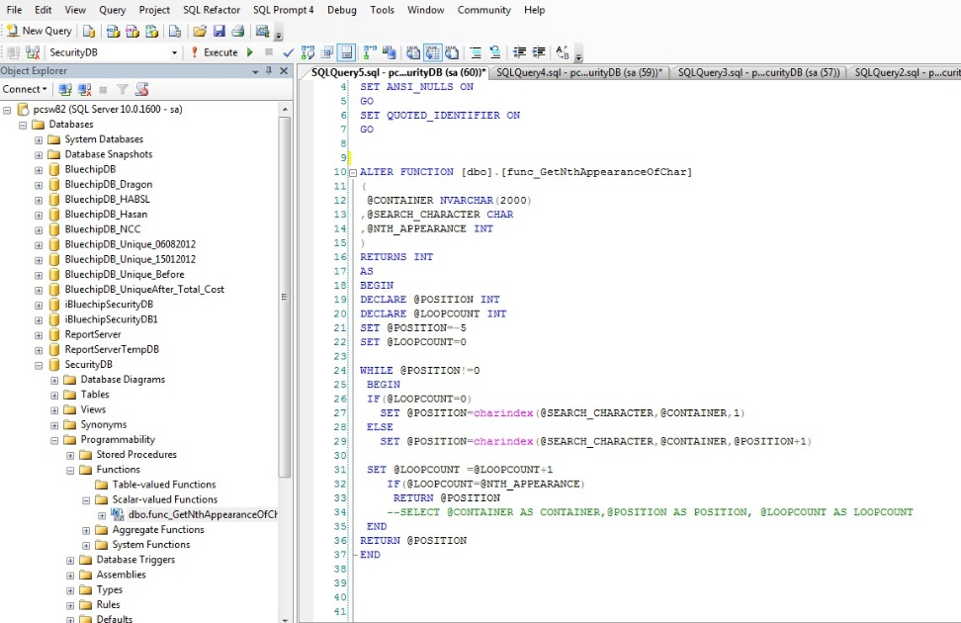
User defined function
User-defined functions are procedures that accept parameters, perform some sort of action, and return the result of that action as a value
The return value can be either a single scalar value or a result set.
A single scalar value is a simple value such as a number
A result set refers to something such as an ADO.NET record set

Slide 63
Scalar valued function
ALTER FUNCTION [dbo].[func_GetNthAppearanceOfChar]
(
@CONTAINER NVARCHAR(2000)
,@SEARCH_CHARACTER CHAR
,@NTH_APPEARANCE INT
)
RETURNS INT
AS
BEGIN
DECLARE @POSITION INT
DECLARE @LOOPCOUNT INT
SET @POSITION=-5
SET @LOOPCOUNT=0
WHILE @POSITION!=0
BEGIN
IF(@LOOPCOUNT=0)
SET @POSITION=charindex(@SEARCH_CHARACTER,@CONTAINER,1)
ELSE
SET @POSITION=charindex(@SEARCH_CHARACTER,@CONTAINER,@POSITION+1)
SET @LOOPCOUNT =@LOOPCOUNT+1
IF(@LOOPCOUNT=@NTH_APPEARANCE)
RETURN @POSITION
--SELECT @CONTAINER AS CONTAINER,@POSITION AS POSITION, @LOOPCOUNT AS LOOPCOUNT
END
RETURN @POSITION
END

Slide 64
Table valued function
ALTER FUNCTION [dbo].[fn_hrm_total_leave_count]
(
@emp_gid int,
@frmdt smalldatetime,
@todt smalldatetime
)
RETURNS @temp_Leave_count TABLE
(
totalLeave int, totalLWP int, totalWeekEnd int,gov_holiday_ho int,other_holiday int,govt_holiday_mill int,govt_holiday_school int
)
AS
BEGIN
DECLARE
@mindt int,
@maxdt int,
@betweendt int,
@totallvdt int,
@total_LWP int,
@total_week_end int,
@total_gov_holiday_HO int,
@total_other_holiday int,
@total_gov_holiday_Mill int,
@total_gov_holiday_School int,
@CHoliday_dt smalldatetime,
@CHoliday_nm varchar(50),
@Record int,
@Counter int
insert into @temp_Leave_count
values(
@totallvdt,@total_LWP, @total_week_end, @total_gov_holiday_HO, @total_other_holiday,@total_gov_holiday_Mill, @total_gov_holiday_School
)
RETURN
END

Slide 65
Trigger
A trigger is a special type of stored procedure that executes when a language event executes.
There are two kinds of triggers: DML triggers and DDL triggers
DML triggers are invoked when a data manipulation language (DML) event takes place in the database
DML Statement include INSERT, UPDATE, DELETE statement that occur when a data is modified in a table or view

Slide 66
DML Triggers…
After Trigger
  Syntax:
    Create Trigger trigger_name On table {After {[Delete] [,] [Insert] [,] [Update]} As sql_statement [...n]
    Example:
      Create Trigger dbo.trMyEquipment_D
      On dbo.MyEquipment After Delete -- For Delete
      As
      Print 'You have just deleted ' + Cast(@@rowcount as varchar) + ' record(s)!' Go

Slide 67
DML Triggers…
Syntax:
    Create Trigger trigger_name On table {After|For {[Delete] [,] [Insert] [,] [Update]} As sql_statement [...n]
    Example:
      Create Trigger dbo.trMyEquipment_D
      On dbo.MyEquipment After Delete -- For Delete
      As Print 'You have just deleted ' + Cast(@@rowcount as varchar) + ' record(s)!' Go

Slide 68
ACID
ACID is a set of properties that guarantee that database transactions are processed reliably
ACID
  Atomicity
    Requires that each transaction is "all or nothing“.
    If one part of the transaction fails, the entire transaction fails, and the database state is left unchanged
  Consistency
    Ensures that any transaction will bring the database from one valid state to another.
    Must be valid according to all defined rules, including but not limited to constraints, cascades, triggers
  Isolation
    Ensures that the concurrent execution of transactions results in a system state that would be obtained if transactions were executed serially.
  Durability
    Durability means that once a transaction has been committed, it will remain so, even in the event of power loss, crashes, or errors.

Slide 69
Thank YOU!

